Slide 1




SAVEETHA SCHOOL OF ENGINEERING
SAVEETHA INSTITUTE OF MEDICAL AND TECHNICAL SCIENCES
CSA0697 DESIGN AND ANALYSIS OF ALGORITHM FOR LOWER BOUND THEORY
TOPIC:
UNIQUE BINARY SEARCH TREE
FACULTY NAME: Dr.Gnana Soundari
By
NAME :K.MAHENDRA REDDY
REG.NO:192210413

Slide 2

Unique Binary Search Tree
Problem Statement:
Given an integer n, return the number of structurally unique Binary Search Trees (BSTs) that have exactly n nodes of unique values from 1 to n.

Slide 3
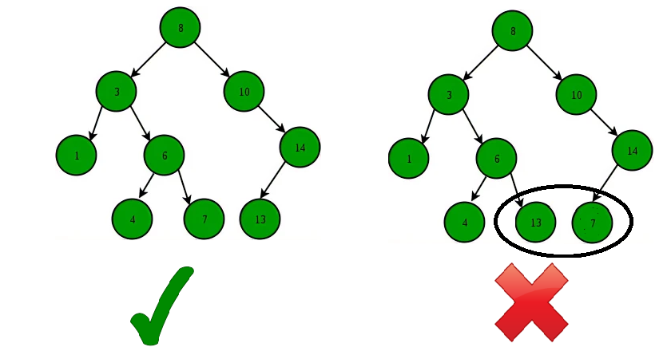
ABSTRACT:
A Binary Search Tree is a data structure that allows efficient searching, insertion, and deletion operations. It is commonly used in various applications, including databases, search engines, and operating systems.
A unique binary search tree is a specific type of binary search tree that has the property of having no duplicate nodes. This uniqueness constraint adds complexity to certain operations, but it can also provide performance benefits in certain scenarios.

Slide 4
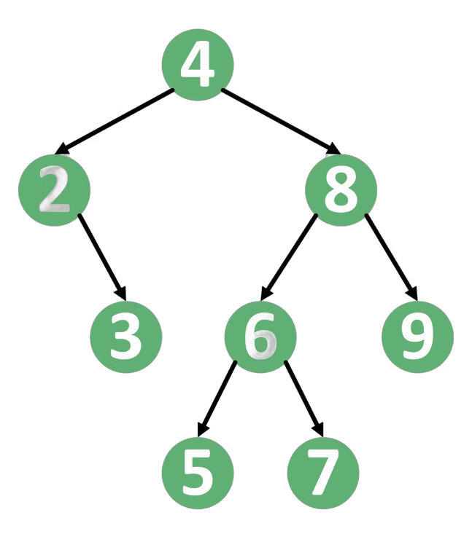
INTRODUCTION:
Definition of a Binary Search Tree
A binary search tree (BST) is a fundamental data structure in computer science. It's a tree-like structure where each node holds a value, and the values are organized in a specific way. The left subtree of a node contains values that are less than the node's value, and the right subtree contains values greater than the node's value.
The key feature of a BST is that it allows for efficient searching, insertion, and deletion operations. The BST's structure makes it possible to quickly find a specific value or determine if a value exists within the tree. It's widely used in various applications, including databases, file systems, and search engines.

Slide 5
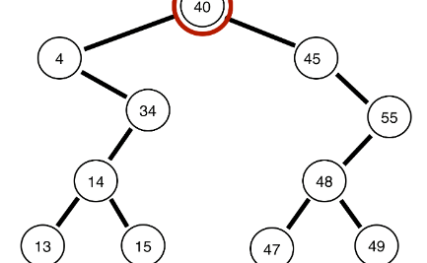
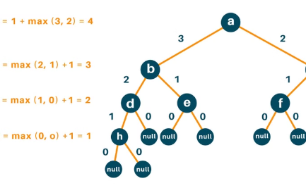
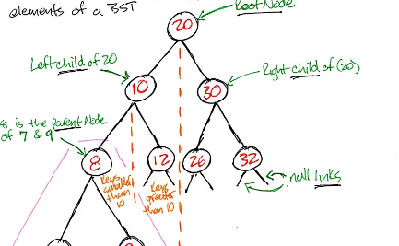
Properties of a Binary Search Tree
Ordered Structure
Height and Depth
Uniqueness
A binary search tree is organized in a hierarchical way. Each node has a value, and the values of the left subtree are always smaller, while the values of the right subtree are always larger. This ordering ensures efficient searching and retrieval of elements.
The height of a binary search tree is the maximum distance from the root node to a leaf node. The depth of a node is the distance from the root to that node. The height and depth play a crucial role in determining the efficiency of search operations.
While a binary search tree can have multiple nodes with the same value, each node represents a unique location in the tree. This uniqueness allows for efficient insertion and deletion operations.

Slide 6
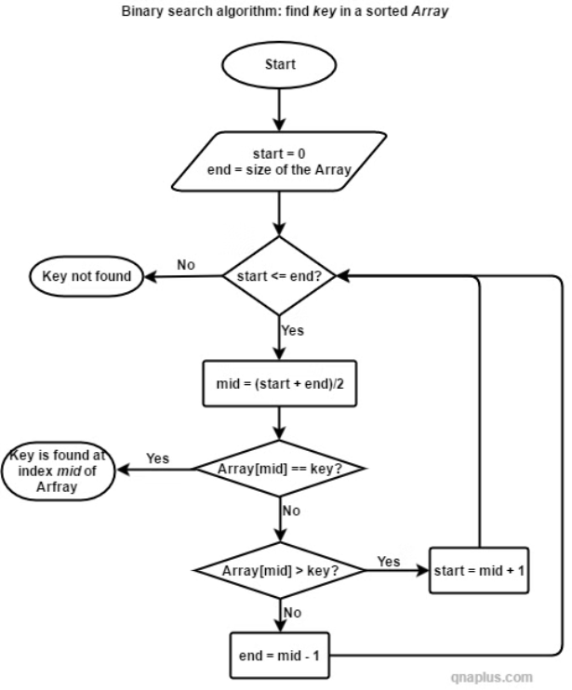
Binary Search Flow chart
A binary search flow chart is a visual representation of the steps involved in a binary search algorithm. It can be used to understand how the algorithm works and to identify potential areas for improvement. The flow chart typically starts with a node representing the input data and ends with a node representing the output data.
The nodes in the flow chart are connected by arrows that represent the flow of control. Each node represents a step in the algorithm, such as comparing the search key to the middle element of the array. The flow chart is designed to be easy to understand and follow, even for someone who is not familiar with the binary search algorithm.

Slide 7

CODE
Here is an example implementation of the algorithm in c program:
#include <stdio.h>
#include <stdlib.h>
int numTrees(int n) {
if (n == 0 || n == 1) {
return 1;
}
int *dp = (int *)malloc((n + 1) * sizeof(int));
dp[0] = 1;
dp[1] = 1;
for (int i = 2; i <= n; i++) {
dp[i] = 0;
for (int j = 0; j < i; j++) {
dp[i] += dp[j] * dp[i - 1 - j];
}
}

Slide 8
CODE
Here is an example implementation of the algorithm in c program:
int result = dp[n];
free(dp);
return result;
}
int main() {
int n = 5;
printf("The number of unique BSTs with %d nodes is: %d\n", n, numTrees(n));
return 0;
}

Slide 9
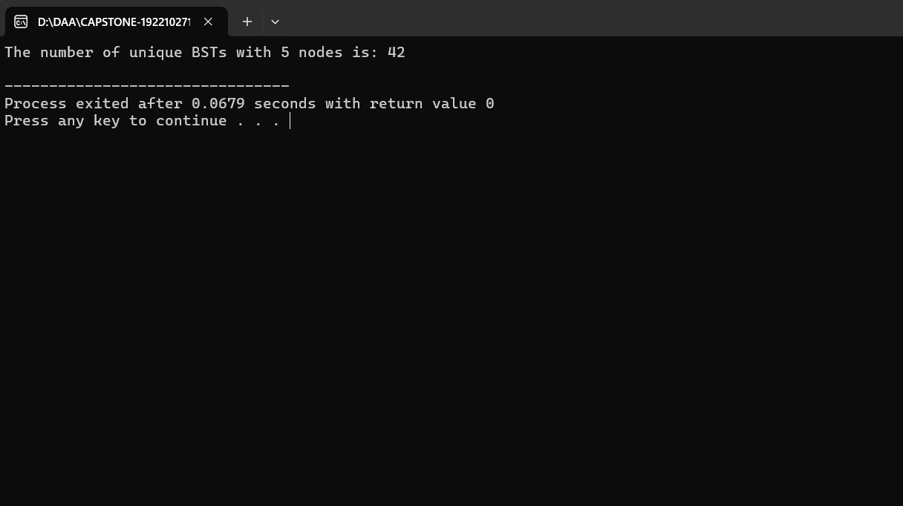
OUTPUT:

Slide 10




Applications of Unique Binary Search Trees
Database Management
Compiler Design
Unique Binary Search Trees are efficient for organizing and retrieving data. They are used in database management systems for indexing and searching data. This improves the speed of data retrieval and makes the database more efficient.
Binary Search Trees are helpful in compiler design for organizing and managing symbols. They provide efficient lookup and retrieval of symbols, which are crucial for code compilation and execution.
Sorting Algorithms
Game Development
Unique Binary Search Trees are also used in various sorting algorithms. For example, the Binary Search Tree Sort algorithm leverages the properties of BSTs to sort data efficiently.
Game trees are used to represent possible moves in games. Unique Binary Search Trees are used to build game trees, enabling efficient game AI algorithms for optimal gameplay strategies.

Slide 11
Time Complexity of Operations on Unique Binary Search Trees
Operation
Time Complexity
Search
O(h)
Insertion
O(h)
Deletion
O(h)
Min/Max
O(h)
Predecessor/Successor
O(h)
The time complexity of these operations depends on the height (h) of the binary search tree. In the best case, where the tree is balanced, the height is logarithmic to the number of nodes (n), resulting in O(log n) time complexity. However, in the worst case, where the tree is skewed, the height can be linear to the number of nodes, leading to O(n) time complexity.
For operations like search, insertion, deletion, finding minimum or maximum values, and finding predecessors or successors, the time complexity is typically proportional to the height of the tree. This is because the algorithm needs to traverse down the tree from the root to the target node or position, which takes time proportional to the height. In a balanced tree, the height is logarithmic, leading to efficient performance, while in a skewed tree, the height can be linear, resulting in less efficient performance.

Slide 12
Challenges and Limitations of Unique Binary Search Trees
Unique binary search trees are efficient data structures, but they face challenges and limitations. One challenge is the potential for skewed trees, where elements are added in a non-random order, leading to unbalanced structures. This can result in poor performance for operations like search, insertion, and deletion, as the tree becomes more like a linked list. Another challenge is the potential for memory overhead, as each node in the tree requires storage for data, as well as pointers to its left and right children.
A limitation of unique binary search trees is that they are not well-suited for certain use cases. For example, if the data is constantly changing or needs to be accessed frequently in a specific order, a different data structure might be more appropriate. Furthermore, unique binary search trees are not inherently thread-safe, meaning that concurrent access from multiple threads could lead to unexpected behavior and data corruption.

Slide 13

Conclusion and Future Directions
In conclusion, Unique Binary Search Trees are a fundamental data structure with numerous applications in computer science. Their efficiency and versatility make them a valuable tool for organizing and searching data.
Future research could explore the development of novel algorithms for generating and manipulating Unique Binary Search Trees, optimizing their performance in specific contexts. Additionally, the integration of Unique Binary Search Trees with other data structures and algorithms could lead to advancements in areas such as artificial intelligence and machine learning.

